Slide 1
Lecture-4

Slide 2
Introducing Classes, Objects & Methods

Slide 3
Introducing Classes, Objects and Methods
A Class is a way to bind the data and functions together.
Syntax:
class classname [extends superclassname]
{
[ fields declaration; ]
[ methods declaration; ]
}
Everything in square brackets is optional.

Slide 4
Fields Declaration
Data is encapsulated in a class by placing data fields inside the body of the class definition.
class Classname
{
data-type variablename;
data-type variablename;
}

Slide 5
Methods Declaration
Syntax:
type methodname(parameter-list)
{
method-body;
}
The type can even be void, if the method does not return any value.

Slide 6
Creating Objects
An object in java is essentially a block of memory that contains space to store all the instance variables. Object in java are created using the new operator. The new operator creates an object of the specified class and returns a reference to the object.
Rectangle rect1; //declare the object
rect1=new Rectangle(); //instantiate the object

Slide 7
Accessing Class Members
The Class members of a class can be accessed using the object-name and the dot operator.
objectname.variablename=value;
objectname.methodname(parameter-list);
Here objectname is the name of the object, variablename is the name of the instance variable inside the object that we wish you access, methodname is the method that we wish to call, and parameter-list is a comma separated list of methodname declared in the class.

Slide 8
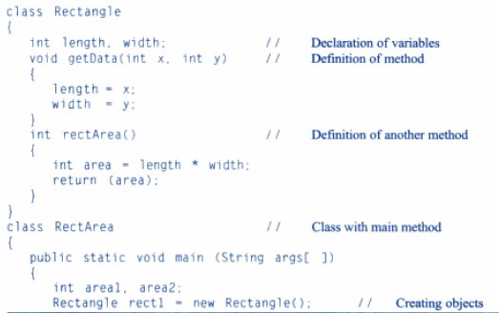

Slide 9
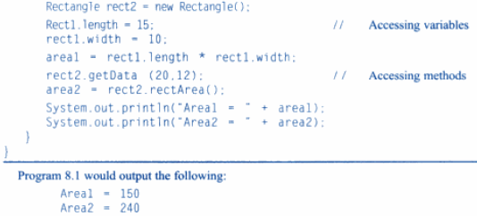

Slide 10
Constructors

Slide 11
Constructors
Constructor is a special type of method that enables an object to initialize itself when it is created.
Constructors have same name as the class.
Constructors have no return type, not even void

Slide 12
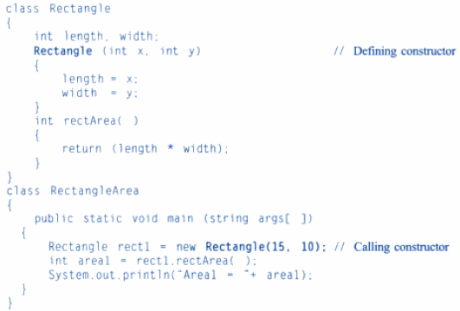

Slide 13
Method Overloading

Slide 14
Method Overloading
It is possible to create methods that have same name, but different parameter lists and different definitions. This is called method overloading. Method overloading is used when objects are required to perform similar tasks but using different input parameters.

Slide 15
Class Inheritance

Slide 16
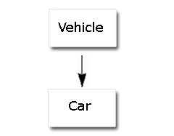
Class Inheritance
The mechanism of deriving a new class from an old one is called inheritance. Another term used for inheritance is reusability. The old class is known as the base class or the super class or parent class and the new one is called the sub class or derived class or child class.
Inheritance may take different forms:
1. Single Inheritance:

Slide 17
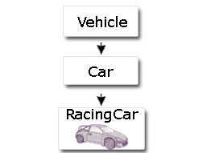
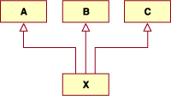
Class Inheritance
2. Multilevel Inheritance:
3. Multiple Inheritance:

Slide 18
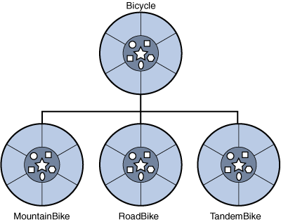
Class Inheritance
4. Hierarchical Inheritance:

Slide 19
Sub-Class Constructor
The subclass constructor uses the keyword super to invoke the constructor method of the superclass. The keyword super is subject to following conditions:
super may only be used with the subclass constructor method
The call to superclass constructor must appear as the first statement within the subclass constructor
The parameters in the super call must match the order and type of the instance variable declared in the super class

Slide 20
Overriding methods
In a class hierarchy, when a method in a subclass has the same name and type signature as a method in its superclass, then the method in the subclass is said to override the method in the superclass. When an overridden method is called from within a subclass, it will always refer to the version of that method defined by the subclass. The version of the method defined by the superclass will be hidden.

Slide 21
Final Class, Variables and Methods
Final Class:
A final class is one that cannot be sub-classed.
Final Variable:
A final variable is a variable which has been initialized to a fixed value which cannot be changed after initialization.
Final Methods:
The final keyword in a method declaration indicate that the method cannot be overridden by subclasses.

Slide 22
Abstract Class
An abstract class is a class that is declared abstract—it may or may not include abstract methods. Abstract classes cannot be instantiated, but they can be sub-classed.
An abstract method is a method that is declared without an implementation (without braces, and followed by a semicolon), like this:
abstract void moveTo(double deltaX, double deltaY);

Slide 23
Abstract Class
If a class includes abstract methods, the class itself must be declared abstract, as in:
public abstract class GraphicObject
{
// declare fields
// declare non-abstract methods
abstract void draw();
}
When an abstract class is subclassed, the subclass usually provides implementations for all of the abstract methods in its parent class.

